Slide 1
Ch3 - Lesson 4:
Arrays in PHP

Slide 2
Arrays in php
Types of arrays:
  Numeric array: an array with a numeric index
  Associative array: stores data with user defined {key=>value} pairs
  Multidimensional array: an array containing one or more arrays and values are accessed using multiple indices.
      Can be numeric or associative

Slide 3
Arrays in php
Numeric arrays: Creating and accessing
$numbers = array( 1, 2, 3, 4, 5);
echo "Value of the array:”;
foreach( $numbers as $value )
{
echo "$value ";
}
Value of the array: 1 3 2 4 5

Slide 4
Arrays in php
Numeric arrays: Creating and accessing
  OR
$numbers=array();
$numbers[0] = "one";
$numbers[1] = "two";
$numbers[2] = "three";
echo "Value of the array:”;
foreach( $numbers as $value )
{
echo "$value ";
}
Value of the array: one two three

Slide 5
Arrays in php
Associative arrays:
  Type of array which stores data using named index called “KEY”
  Best alternative of numeric arrays in times when numeric index is not so important.
  Because we can use strings as numeric indices in associative arrays

Slide 6
Arrays in php
Example:
$age = array(“Alemu"=>"35", “Tsegaye"=>"37", “Lemma"=>"43");
$person=array([“name”=>”Abebe”, “dept”=“SE”, “age”=>23], [“name”=>”Birtukan”, “dept”=>”CS”, “age”=>26]);

Slide 7
Arrays in php
OR:
$age['Alemu'] = "35";
$age[‘Tsegaye'] = "37";
$age[‘Lemma'] = "43";

Slide 8
Arrays in php
Accessing assoc. array element
<?php
$age = array(“Alemu"=>"35", “Tsegaye"=>"37", “Lemma"=>"43");
echo “Alemu is " . $age[‘Alemu'] . " years old.";
?>

Slide 9
Arrays in php
Looping through an associative array
<?php
$age = array(“Alemu"=>"35", “Tsegaye"=>"37", “Lemma"=>"43");
foreach($age as $x => $value) {
echo "Key=" . $x . ", Value=" . $value;
echo "<br>";
}
?>

Slide 10
Arrays in php
Multidimensional arrays
  An array which containing one or more arrays (array of arrays)
  Two, three, four, five dimensional arrays are available but more than three dimensions are hard to manage
  Dimension of arrays determined by its number of indices

Slide 11
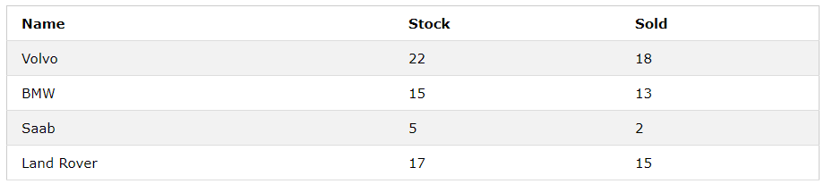
Arrays in php
Two-dimensional arrays

Slide 12
Arrays in php
Two-dimensional arrays
$cars = array
(
array("Volvo",22,18),
array("BMW",15,13),
array("Saab",5,2),
array("Land Rover",17,15)
);
$cars=array([“name”=>”Volvo”,”stock”=>22,”sold”=>18],[“name:=>”BMW”,”stock”=>15,”sold”=>13],[…]);

Slide 13
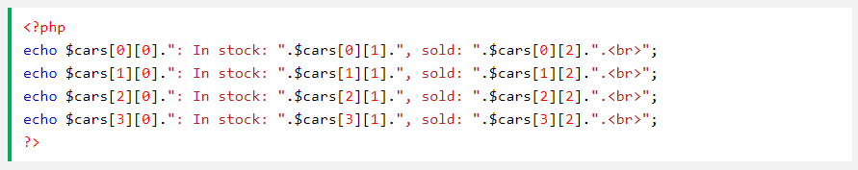
Arrays in php
Two-dimensional arrays

Slide 14
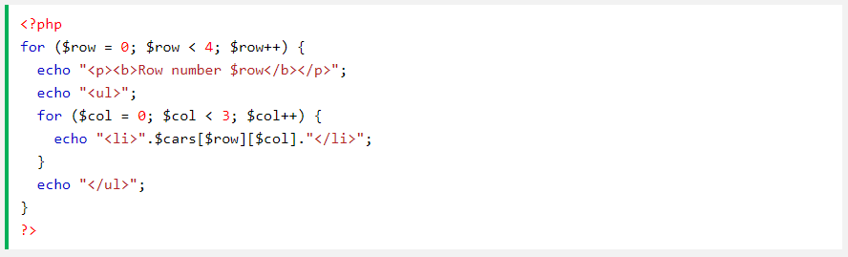
Arrays in php
Two-dimensional arrays
  We can also use a nested for loop to get the elements of the $cars array.

Slide 15
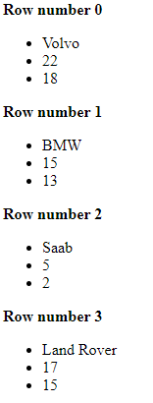
Arrays in php
Two-dimensional arrays

Slide 16
Arrays in php
Question:
Use foreach loop to extract the values of the above array.

Slide 17
thankYou();

